Slide 1


How to access and use the World Bank's poverty and inequality data
R & Stata Workshop
Inequality Winter School
Canazei
09/10 January 2025

Slide 2
The Poverty and Inequality Platform (PIP)
PIP is the World Bank’s online data portal for poverty and inequality estimates at the country, regional and global levels.
PIP is the source of data for monitoring SDG 1 (end poverty everywhere by 2030).
PIP is updated twice a year – in March/April and September/October (Register for our newsletter here).
PIP is managed by the Global Poverty and Inequality Data (GPID) team, in the World Bank’s Development Economics Data Group.
However, the publication of PIP data is a huge collaborative work across multiple country and regional teams in the Poverty and Equity Global Practice of the World Bank.
PIP data is available online through:
API (https://pip.worldbank.org/api)
User Interface (UI) – for journalists, quick data access and visualizations.(https://pip.worldbank.org/home)
Wrappers – for advanced users, researchers, students:
Stata: https://github.com/worldbank/pip
R: https://github.com/worldbank/pipr
WORKWITH PRIVATE SECTOR
TRIBNAL

Slide 3















People currently working on PIP
Andres Castaneda
Christoph Lakner
Daniel Mahler
Dean Jolliffe
Martha Viveros
Minh Nguyen
Nishant Yonzan
Samuel Tetteh-Baah
Tony Fujs
Zander Prinsloo
Giorgia Cecchinato
Rossana Tatulli
Diana Garcia Rojas
Carolina Diaz-Bonilla
Gabriel Lara Ibarra

Slide 4


Giorgia Cecchinato
@giorgiacek
gcecchinato@worldbank.org

Slide 5
Today’s Plan
PART 1 (9th Jan) Introduction 1h
Scope of PIP: from surveys to poverty measures 15”
API and UI: quick overview 5”
PIP wrappers overview 35” Stata and R
Access country level estimates (pip) (get_stats)
Access aggregate-level estimates (pip wb) (get_wb)
Access group data parameters (pip gd) (get_gd)
Special arguments:
Interpolated values (fillgaps) & nowcasts (nowcast)
Population share (popshare)
PART 2 (10th Jan) Use Cases 1h
In-depth examples (R but Stata code available)
Replicate PIP survey and reference year data 15”
Derive the IPL using PIP Data 15”
Visualization exercise (if time allows): SPL vs IPL 15”

Slide 6
Today’s Plan
PART 1 (9th Jan) Introduction 1h
Scope of PIP: from surveys to poverty measures 15”
API and UI: quick overview 5”
PIP wrappers overview 35” Stata and R
Access country level estimates (pip) (get_stats)
Access aggregate-level estimates (pip wb) (get_wb)
Access group data parameters (pip gd) (get_gd)
Special arguments:
Interpolated values (fillgaps) & nowcasts (nowcast)
Population share (popshare)
PART 2 (10th Jan) Use Cases 1h
In-depth examples (R but Stata code available)
Replicate PIP survey and reference year data 15”
Derive the IPL using PIP Data 15”
Visualization exercise (if time allows): SPL vs IPL 15”

Slide 7
PART 1

Slide 8
1. Scope of PIP: Objective
Objective: Analyzing monetary poverty:
WORKWITH PRIVATE SECTOR
TRIBNAL
Monetary concepts of poverty
Absolute
$2.15 World Bank
Relative
60% of median (OECD)
Weakly relative
max(2.15,1.15 + 50% of median) World Bank’s societal poverty line*
Metrics: Poverty headcount, poverty gap, poverty severity, Watts.
Additional metrics:
World Bank’s multi-dimensional poverty measure (MPM).
Inequality measures (Gini, Thiel, polarization).
Shared prosperity measures (prosperity gap, shared prosperity).
*On the definition of societal poverty line see this blogpost.
Notes:
Monetary Concepts of Poverty:
Absolute Poverty ($2.15, World Bank):
Basically IPL
Represents the minimum level of income needed to meet basic human needs in the poorest countries.
Adjusted for purchasing power parity (PPP) to account for cost-of-living differences across countries.
Relative Poverty (60% of Median, OECD):
Used by the OECD
Defined as individuals earning less than 60% of the median income in a society.
Focuses on inequality and the relative standard of living compared to the rest of the population.
Weakly Relative Poverty (Societal Poverty Line, World Bank):
Combines elements of absolute and relative poverty (blue for absolute and red for relative part).
Formula: max(2.15, 1.15 + 50% of median income).
Accounts for societal standards while ensuring a floor of $2.15 to reflect global poverty.
Balances basic needs with societal norms, especially in higher-income countries.
Additional Measures:
Multi-dimensional Poverty Measure (MPM, World Bank):
Goes beyond monetary metrics to include education, health, and living standards.
Captures the multifaceted nature of poverty and deprivation.
Inequality and Shared Prosperity Measures:
Gini
Shared prosperity

Slide 9
1. Scope of PIP: Methodology
Step 1
Acquiring Household Data
Step 2
Constructing Welfare aggregates
Step 3
Adjusting Welfare aggregates
Step 4
Calculating survey estimates
Step 5
Calculating regional aggregates
Source: PIP Methodological handbook

Slide 10
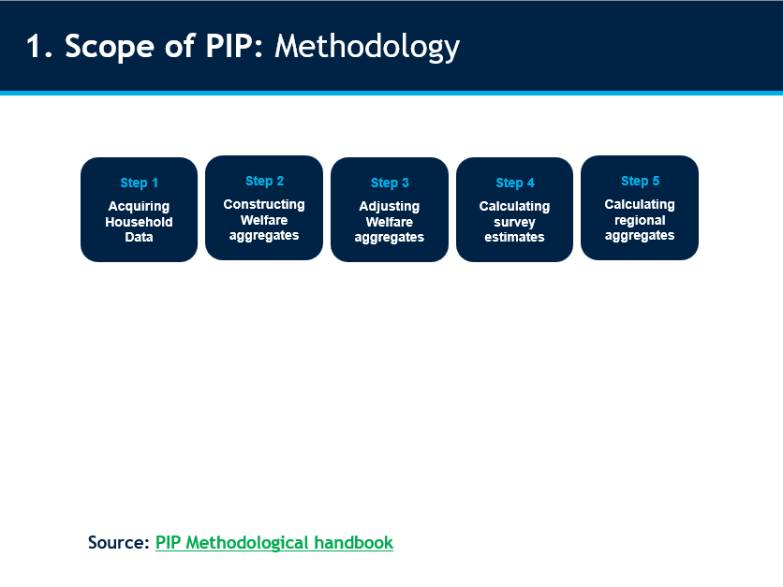
Step 1
Acquiring Household Data
Sources:
LIC: Surveys collected by National Statistical Offices
HIC:
Europe: EU-SILC.
Other (and earlier years): Luxemburg Income Study (LIS)
Data type: welfare (consumption/income) data at the unit or group level.
Microdata are available online. BUT NOT ON PIP.
Source: Chapter 1 PIP Handbook
Notes:
Note on HIC:
For high-income countries in the European Union (with the exception of Germany), the data are obtained from the EU Statistics on Income and Living Conditions (EU-SILC).
EU-SILC data are partly obtained from surveys and partly obtained from administrative records.
For other high-income economies (Australia; Canada; Germany; Israel; Japan; South Korea; Taiwan, China; the United Kingdom; and the United States) data from the Luxembourg Income Study (LIS) Database are used.
These data rely on surveys carried out by NSOs or by academic institutions. Data from the LIS database are also used for high-income countries from the European Union for years predating EU-SILC, which naturally causes a break in the series.

Slide 11
Step 2
Constructing Welfare aggregates
Income vs Consumption (welfare_type) -> consumption preferred.
Zeros dropped.
Micro or Grouped Data (distribution_type)
Additional comparability considerations:
Questionnaire design changes.
Equivalence scales (-> not used)
Spatio/temporal adjustments.
Imputed rent ( -> excluded)
Tracked in PIP: comparable_spell and survey_comparability.
Source: Chapter 2 PIP Handbook
Notes:
Monetary poverty is estimated from an aggregation of households’ income or from the monetary value of their consumption. We refer to such aggregates jointly as welfare aggregates.
Welfare aggregates = exactly how me sum-up consumption variables/income + how we then reduce it to per capita, per day numbers.
Grouped data
- Deaton and Zaidi (2002) for the specific theory/methodology.
The variables comparable_spell and survey_comparability contain the necessary information. The latter has the following logic: The oldest comparable series in each country starts with the value zero (0). When comparability is broken, the value changes to one (1) for the year of the break and it goes on until the comparability is broken again in a subsequent year. The process repeats until the most recent survey data point available.
In order to guide users about when poverty can be compared over time within a country, PIP’s line charts for countries only connect poverty estimates when these are comparable. In addition, PIP contains metadata on the comparability of poverty estimates within countries over time.

Slide 12
Step 3
Adjusting Welfare aggregates
Consumer Price Indices (CPIs) (cpi) & Purchasing Power Parities (PPPs) (ppp) source code
Derivation of the International Poverty Line (poverty_line) Which $2.15/day in 2017 PPPs and is based on the median of harmonized national poverty lines from the poorest countries.
Derivation of higher poverty lines Which are $3.65 and $6.85 in 2017 PPPs and are based on median values of national poverty lines of lower- and upper-middle income countries, respectively.
Derivation of societal poverty line (spl)source code
Source: Chapter 3 PIP Handbook

Slide 13
Step 4
Calculating survey estimates
Poverty and Inequality metrics are calculated using adjusted welfare aggregates.
Calculations are based on formula in Haughton and Khandker (2009), Handbook on Poverty and Inequality.
Source code is available on github through the package wbpip. Check the methodological handbook for links to the specific functions.
Source: Chapter 4 PIP Handbook

Slide 14
Step 5
Calculating regional aggregates
Few steps:
Extrapolations and/or Interpolations (fill_gaps)
Nowcasts (nowcast)
Regional classification
Population adjustments
Coverage rules applied.
Source: Chapter 5 PIP Handbook
Notes:
Extrapolations: Welfare aggregates are extrapolated forward or backward to a reference year using national account growth rates (real GDP p.c. or HFCE p.c.). Passthrough rate is 0.7 for consumption and 1 for income. This assumes distribution-neutral growth, keeping inequality constant, and adjusts the welfare distribution year-by-year based on national economic changes.
Interpolations: When the reference year falls between two surveys, poverty is interpolated using either "same direction" or "diverging directions" approaches based on whether growth trends in survey means and national accounts align. - "Same direction" interpolation estimates the survey mean at the reference year and adjusts both welfare distributions, averaging their poverty estimates with inverse distance weights.
"Diverging directions" interpolation extrapolates poverty forward and backward from the nearest surveys, then averages the estimates.

Slide 15
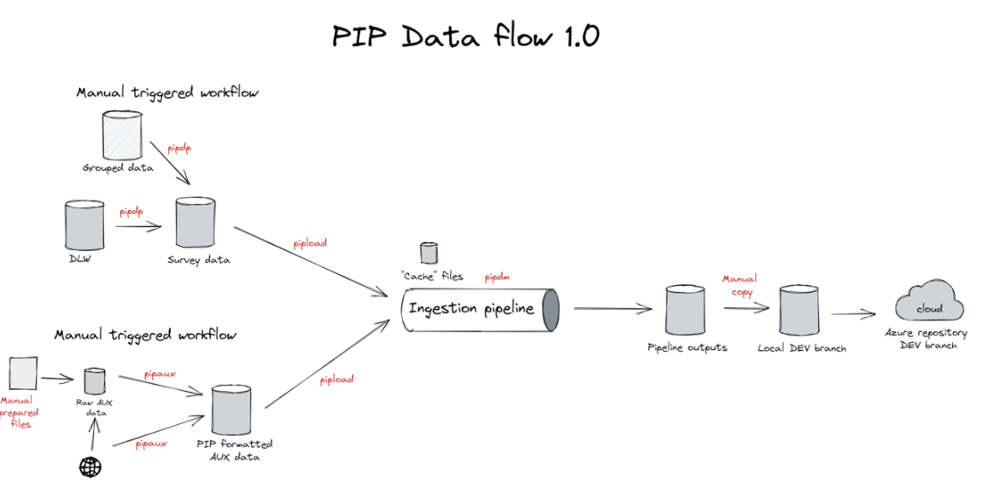
1. Scope of PIP: Pipeline

Slide 16
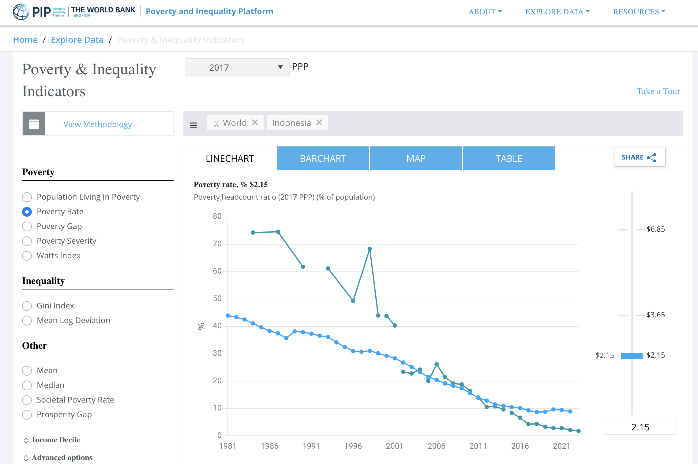
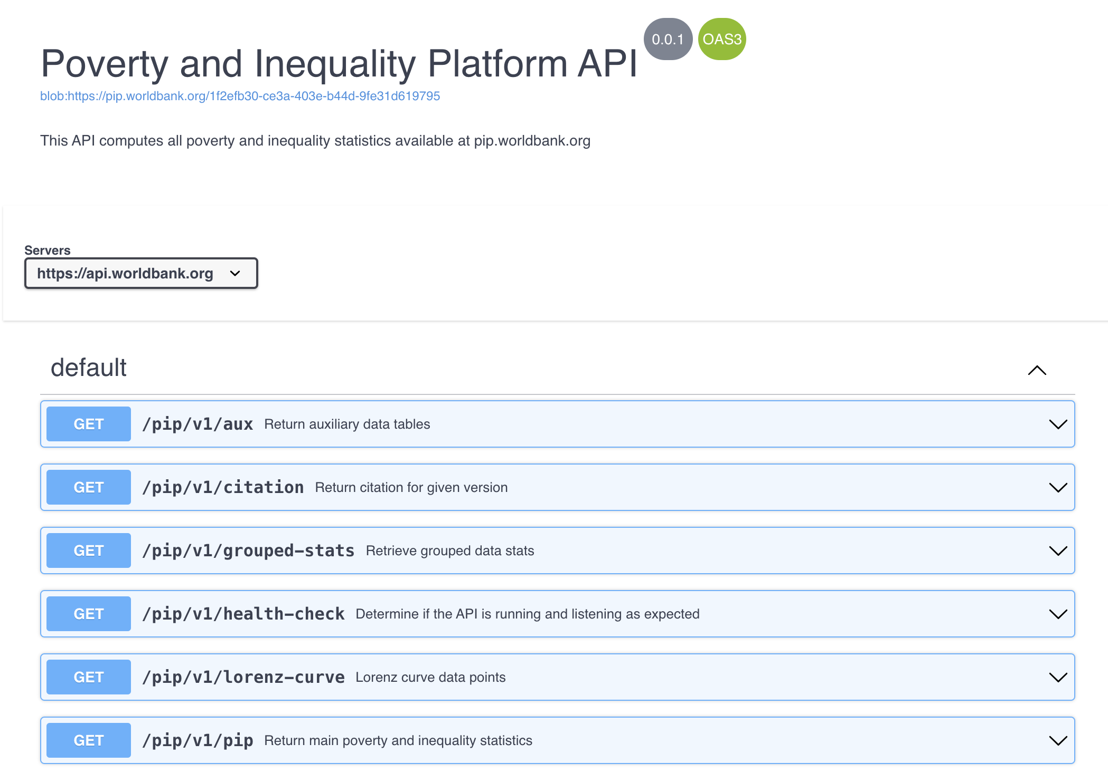
2. API and UI
You can access all data with the UI:
https://pip.worldbank.org/poverty-calculator
You can call the API directly:
https://pip.worldbank.org/api

Slide 17
3. PIP wrappers cheatsheet
R
https://github.com/worldbank/pipr
Stata
https://github.com/worldbank/pip
get_stats() poverty and inequality metrics, country level
country “all” , “Albania” or “ALB” , year “all” or #
povline default is 2.15$, 2017 PPP
popshare instead of povline, 0.1-1
fillgaps nowcasts true/false
get_stats(country = “ALB”, year = 2018, povline = 1.9)
pip
country, year “”
povline “”
popshare “”
fillgaps nowcasts “”
pip country(ALB) year(2018) povline(1.9)
get_wb() poverty and inequality metrics, region level
country “all”, year “all”
povline default is 2.15$, 2017 PPP
get_wb() , which equals to:
get_stats(country = “all”, year = “all”, subgroup = ”wb”)
pip wb poverty and inequality metrics, region level
region, ”all” or e.g. SAR, year “all” or #
povline “”
pip wb, clear region(SAR LAC)
get_aux() auxiliary tables used in metrics estimation
get_aux() gets all available tables gdp, cpi, countries,…
get_aux(“countries”), equals to get_countries()
pip tables auxiliary tables used in metrics estimation
pip tables “”
pip tables, table(countries) “”
get_gd() group data metrics and parameters
estimate “lorenz” “params” “stats”
get_cp() / get_cp_ki() country profile data
See ?pip_cp/?pip_cp_ki

Slide 18
4. PIP Overview
All data/code/slides for this lecture are available in a public repo:
https://github/giorgiacek/pip_canazei_2025
I will mostly follow a Quarto (R) document (code in the repo, html in the repo too) but Stata code is available as well:
R ~03_R\
Today: R_part_1.qmd/.html
Tomorrow: R_part_2.qmd/.html
How to see the .html version in your browser: download the single .html file from the repository, or clone the whole repository, then open the file. It will open in your default browser.
Stata ~04_Stata\
Today: Stata_part_1.do
Tomorrow: Stata_part_2.do

Slide 19
open R_part_1.qmd
(or .html)

Slide 20
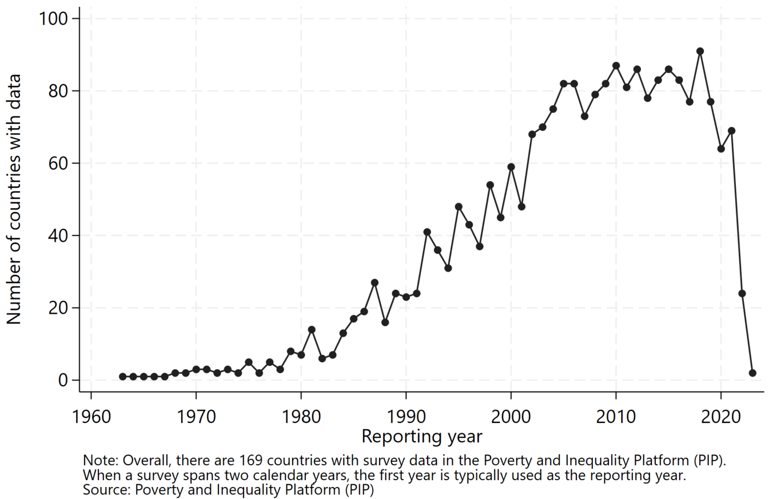
Notes on fill_gaps
Not all 169 countries in PIP have survey estimates of poverty every year.
For regional and global aggregation of poverty data, how do we fill in the gaps for every year?

Slide 21
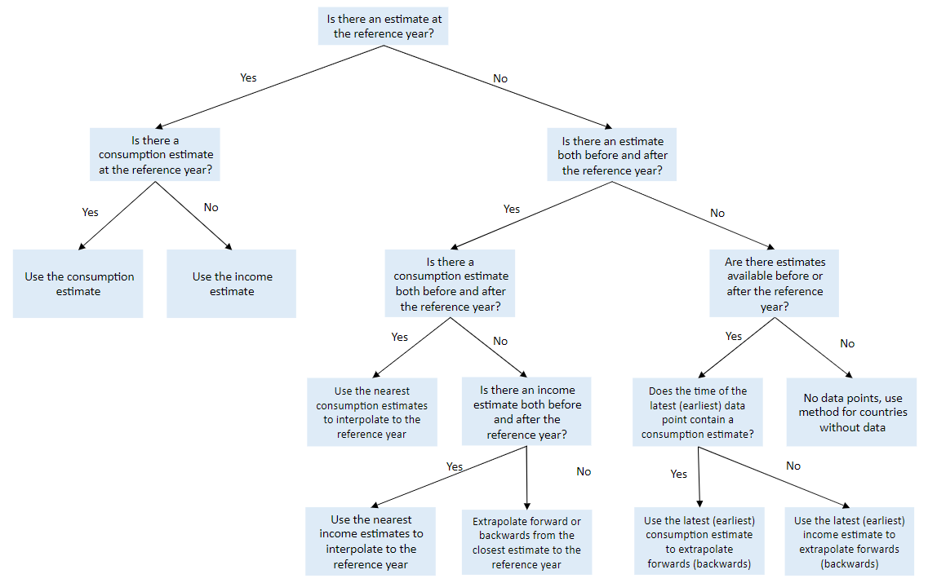
Notes on fill_gaps
Good news: PIP does all this for you with the fillgaps option!
Source: Poverty and Inequality Platform Methodology Handbook
Notes:
To do
Take notes and practice
Explain that people can access methodological handbook

Slide 22
PART 2

Slide 23
Today’s Plan
PART 1 (9th Jan) Introduction 1h
Scope of PIP: from surveys to poverty measures 15”
API and UI: quick overview 5”
PIP wrappers overview 35” Stata and R
Access country level estimates (pip) (get_stats)
Access aggregate-level estimates (pip wb) (get_wb)
Access group data parameters (pip gd) (get_gd)
Special arguments:
Interpolated values (fillgaps) & nowcasts (nowcast)
Population share (popshare)
PART 2 (10th Jan) Use Cases 1h
In-depth examples (R but Stata code available)
Replicate PIP survey and reference year data 15”
Derive the IPL using PIP Data 15”
Visualization exercise (if time allows): SPL vs IPL 15”

Slide 24
open R_part_2.qmd
(or .html)

Slide 25
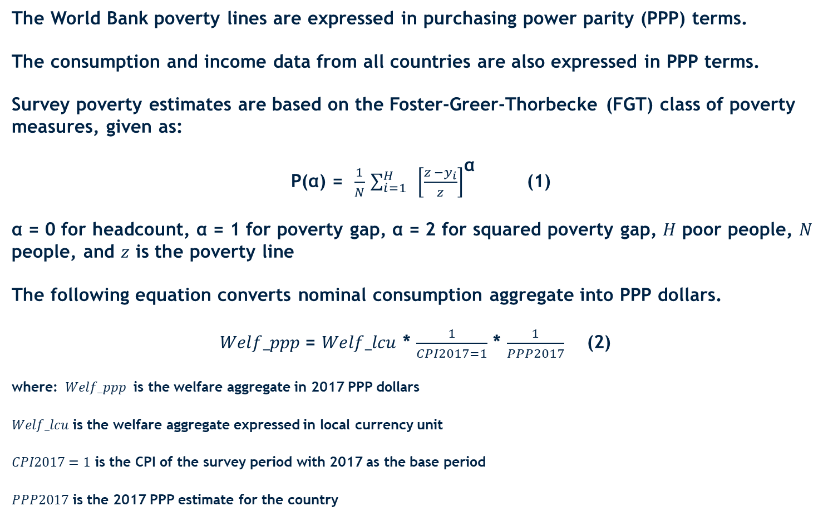
1. Notes on “2. Replicate PIP data (survey years)”
The World Bank poverty lines are expressed in purchasing power parity (PPP) terms.
The consumption and income data from all countries are also expressed in PPP terms.
Survey poverty estimates are based on the Foster-Greer-Thorbecke (FGT) class of poverty measures, given as:
P(α) = $\frac{1}{N}$ ${\sum_{i=1}^{H}{ }\left[\frac{z −y_{i}}{z}\right]}^{\text{α}}$ (1)
α = 0 for headcount, α = 1 for poverty gap, α = 2 for squared poverty gap, $H$ poor people, $N$ people, and $z$ is the poverty line
The following equation converts nominal consumption aggregate into PPP dollars.
$Welf_ppp$= $Welf_lcu$ * $\frac{1}{CPI2017=1}$ * $\frac{1}{PPP2017}$ (2)
where: $Welf_ppp$ is the welfare aggregate in 2017 PPP dollars
$Welf_lcu$ is the welfare aggregate expressed in local currency unit
$CPI2017=1$ is the CPI of the survey period with 2017 as the base period
$PPP2017$ is the 2017 PPP estimate for the country
WORKWITH PRIVATE SECTOR
TRIBNAL
Notes:
This new method is used for the first time to derive all three lines consistently.

Slide 26
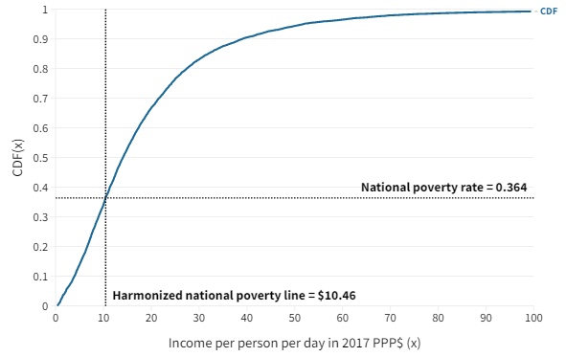
2. Notes on “5. Calculate the IPL”
Steps followed in deriving the international poverty line and higher lines
Derive harmonized national poverty lines using:
national poverty rates reported in WDI
welfare distributions, all expressed in per capita PPP units
Select one line per country that is closest in time to the 2017 ICP reference year
Categorize countries according to the World Bank’s income classification in the years the surveys were conducted.
The global poverty lines are the medians of the harmonized, national poverty lines, by income group.
New method addresses several issues with the current methodology:
The 15 countries upon which the $1.90 line is based are not the poorest countries in the world, as often times assumed.
Their national poverty lines are not in comparable units; some are in per capita terms, others in adult equivalent terms
Their national poverty lines are old, long CPI series are needed to convert them to the ICP reference year
Using the mean national poverty line instead of the median is more vulnerable to outliers.
New method is not entirely new.
Used to establish the robustness of the current line of $1.90 [Jolliffe and Prydz 2016]
Used to derive higher lines adopted by the Bank [Jolliffe and Prydz 2016]
An example with Bolivia 2017
WORKWITH PRIVATE SECTOR
TRIBNAL

Slide 27
2. Notes on “5. Calculate the IPL”
Steps followed in deriving the new international poverty line and higher lines
Derive harmonized national poverty lines using:
national poverty rates reported in WDI
welfare distributions, all expressed in per capita PPP units
Select one line per country that is closest in time to the 2017 ICP reference year
Categorize countries according to the World Bank’s income classification in the years the surveys were conducted.
The global poverty lines are the median values of the harmonized, national poverty lines, by income group. The median for low-income countries is the international poverty line.
WORKWITH PRIVATE SECTOR
TRIBNAL

Slide 28
Questions? Feedback?
WORKWITH PRIVATE SECTOR
TRIBNAL
gcecchinato@worldbank.org
Github: @giorgiacek
Thank you!

Slide 29
Resources
Stata and R wrappers for the Poverty and Inequality Platform (PIP)
Poverty and Inequality Platform (PIP) Methodology Handbook
WORKWITH PRIVATE SECTOR
TRIBNAL
Notes:
GC, to do: Add repository with Stata and R code to access.

